Slide 1

Root anatomies and hydraulics with GRANAR-MECHA
Adrien Heymans
Valentin Couvreur
Guillaume Lobet
Marco d’agostino
Notes:
Add Q

Slide 2
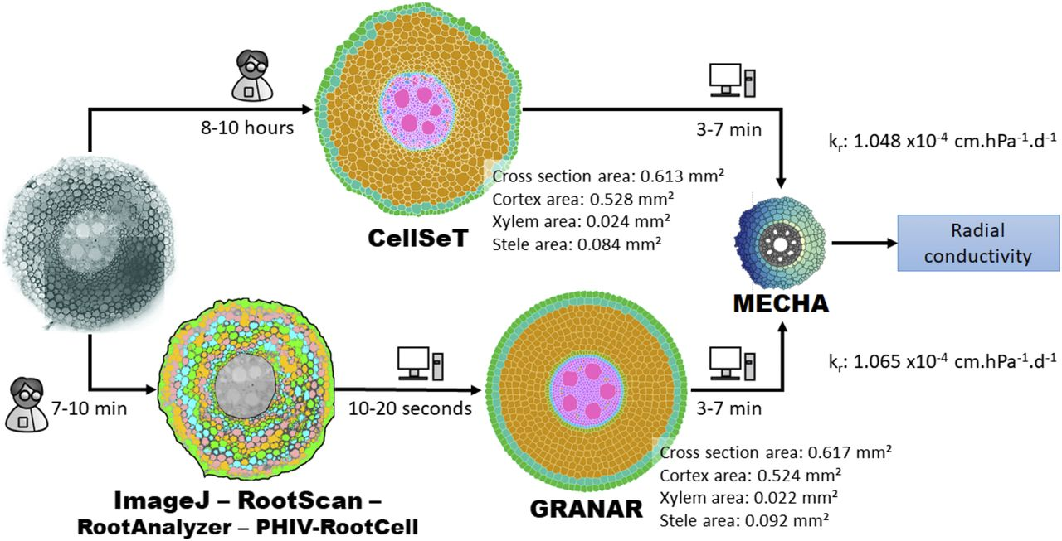
Intro
Load
Modify
Run
Visualise
Export

Slide 3
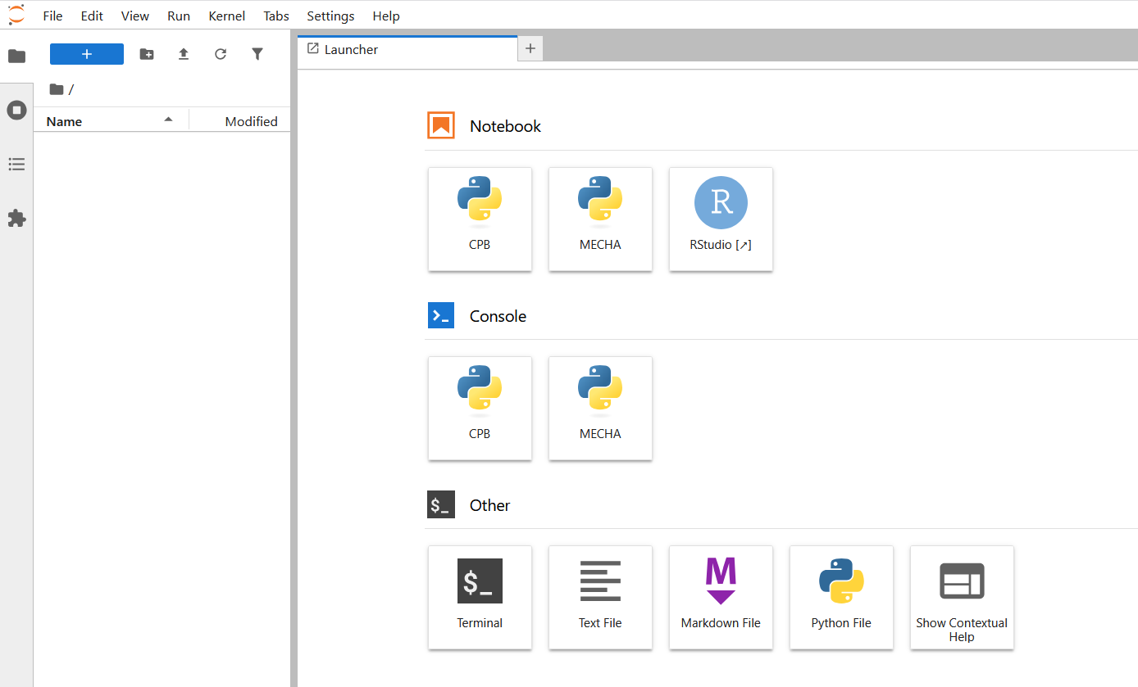
SIMULATING ROOT ANATOMIES
- GRANAR & MECHA -
- Modelling Root Hydraulic Anatomies -
3

Slide 4
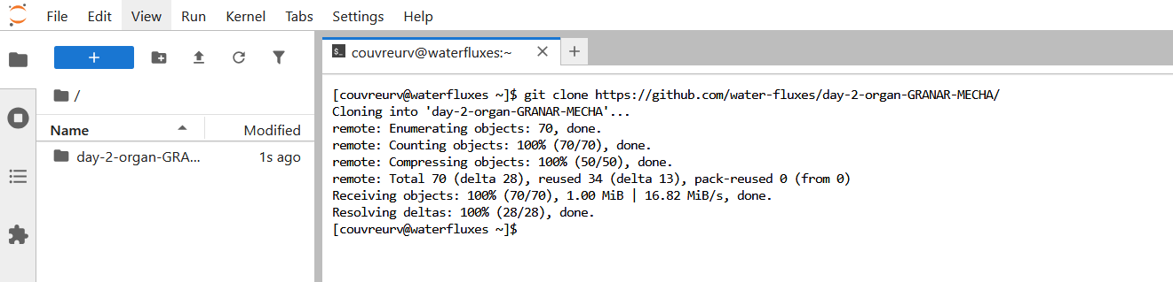
SIMULATING ROOT ANATOMIES
- GRANAR & MECHA -
git clone https://github.com/water-fluxes/day-2-organ-GRANAR-MECHA/
- Modelling Root Hydraulic Anatomies -
4

Slide 5
SIMULATING ROOT ANATOMIES
- GRANAR -
- Modelling Root Hydraulic Anatomies -
5

Slide 6
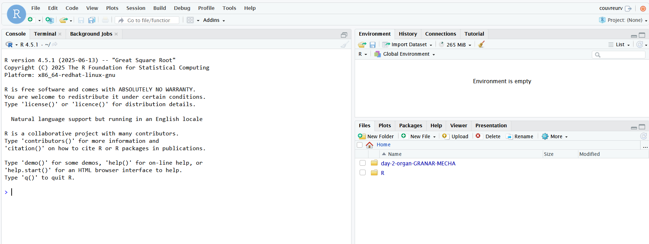
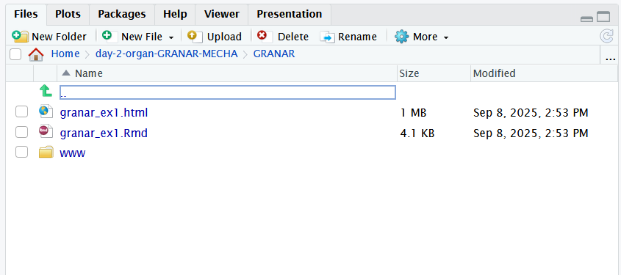
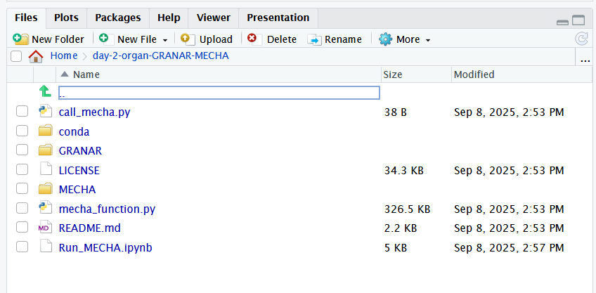
SIMULATING ROOT ANATOMIES
- GRANAR -
- Modelling Root Hydraulic Anatomies -
6

Slide 7
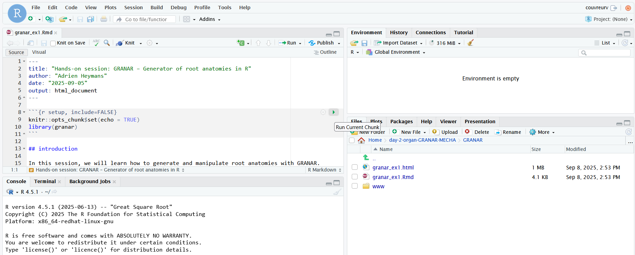
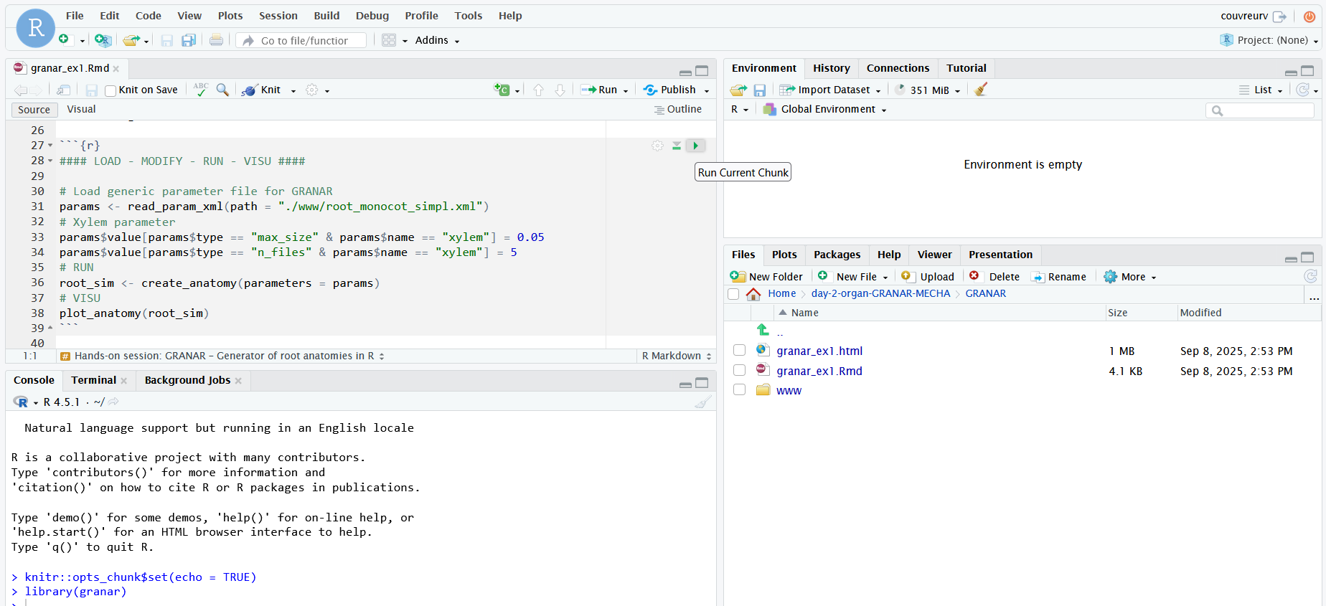
SIMULATING ROOT ANATOMIES
- GRANAR -
- Modelling Root Hydraulic Anatomies -
7

Slide 8
SIMULATING ROOT ANATOMIES
- MECHA -

Slide 9
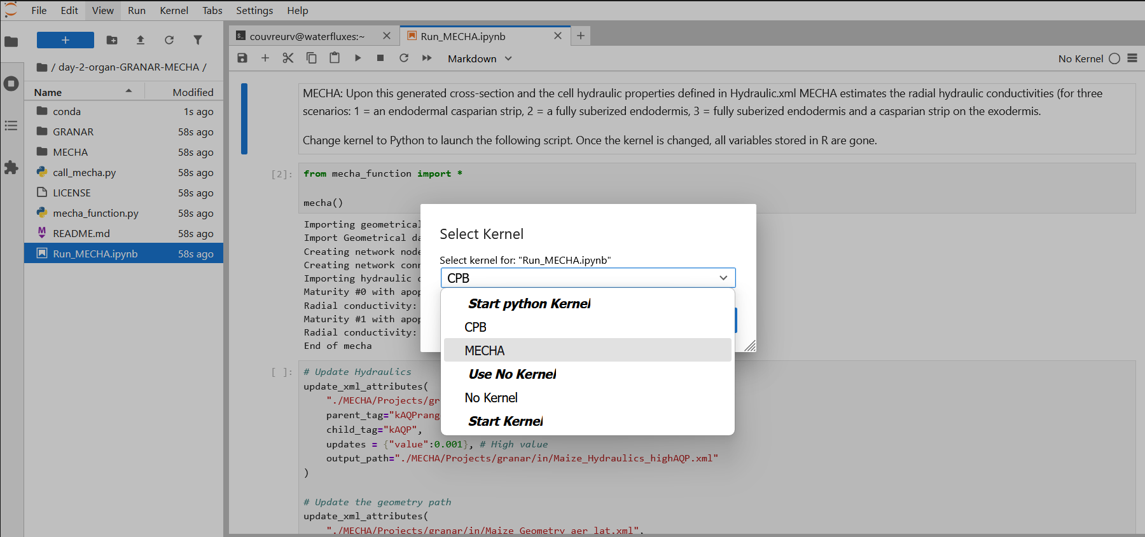
SIMULATING ROOT ANATOMIES
- GRANAR -
git clone https://github.com/water-fluxes/day-2-organ-GRANAR-MECHA/
- Modelling Root Hydraulic Anatomies -
9

Slide 10
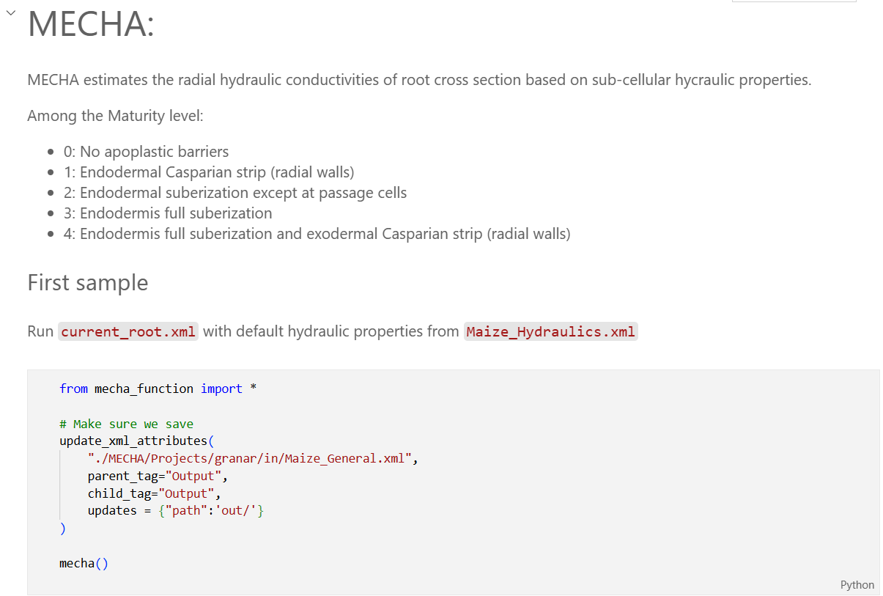
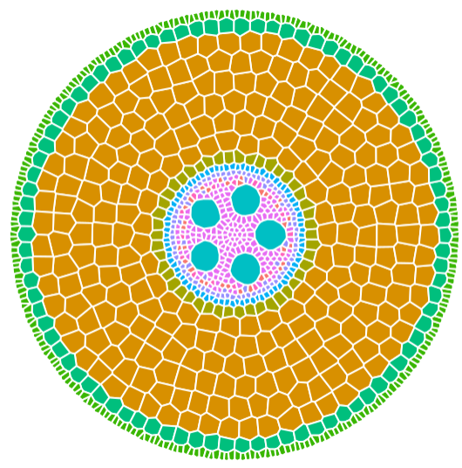
SIMULATING ROOT ANATOMIES
- MECHA -
- Modelling Root Hydraulic Anatomies -
10

Slide 11
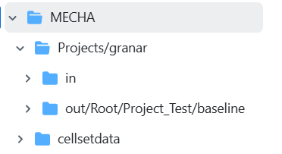
SIMULATING ROOT ANATOMIES
- MECHA -
General
Boundary conditions
Geometry
Hydraulics
Hormones

Slide 12
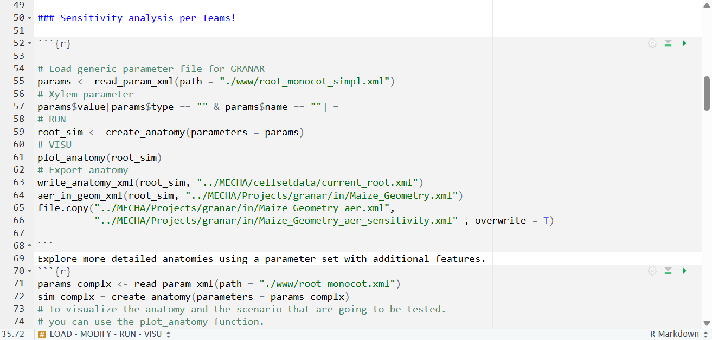
SIMULATING ROOT ANATOMIES
- GRANAR -
Back to R

Slide 13
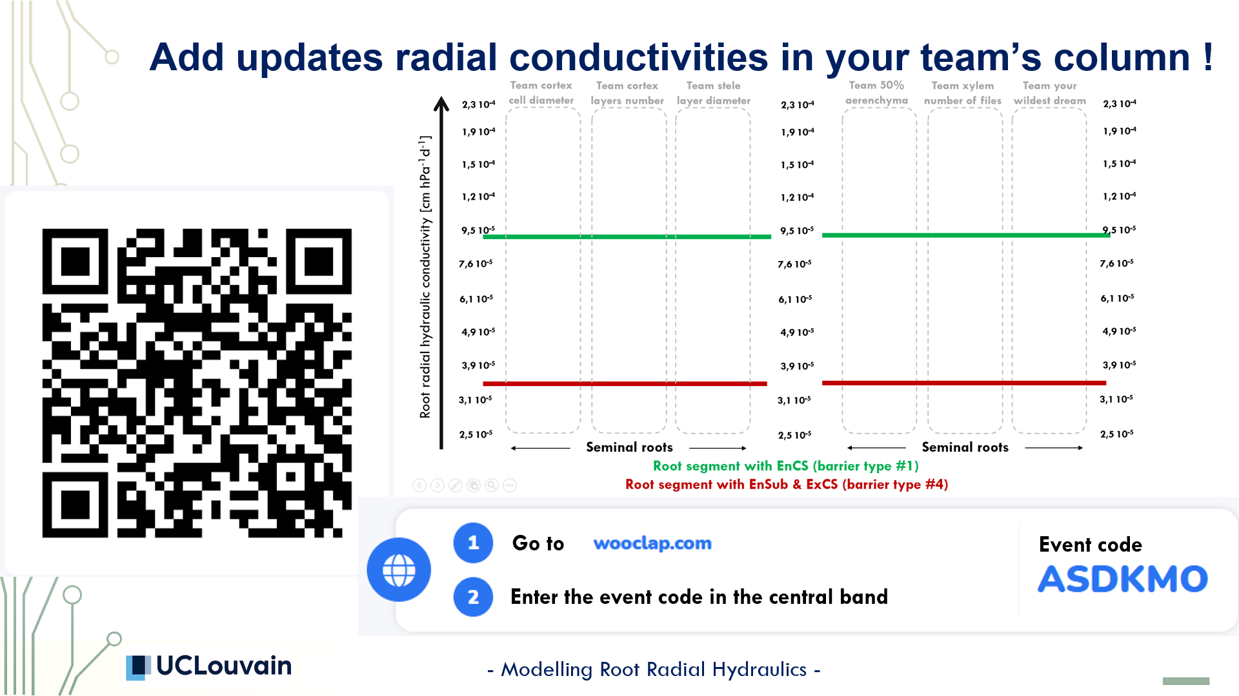

Slide 14
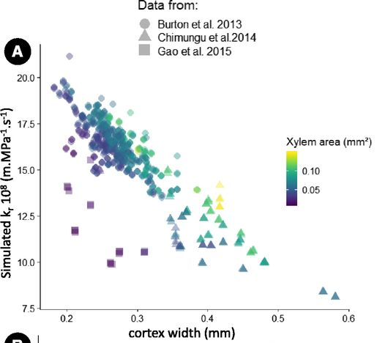
SENSITIVITY ANALYSIS
- Modelling Root Hydraulic Anatomies -
14

Slide 15
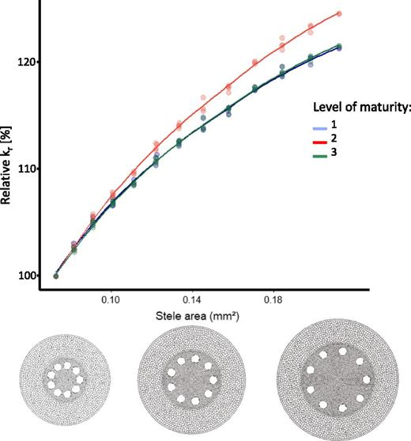
SENSITIVITY ANALYSIS
- Modelling Root Hydraulic Anatomies -
15

Slide 16
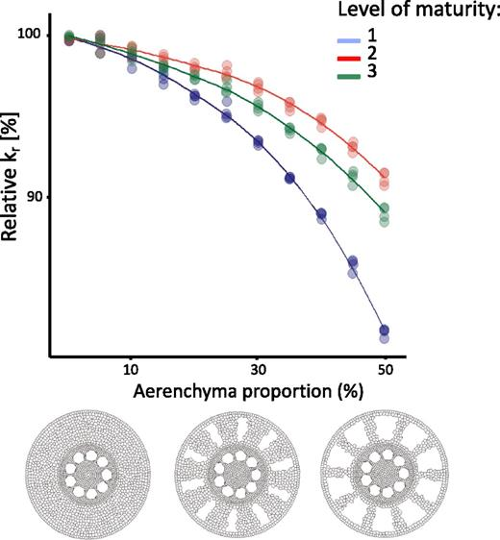
SENSITIVITY ANALYSIS
- Modelling Root Hydraulic Anatomies -
16

Slide 17
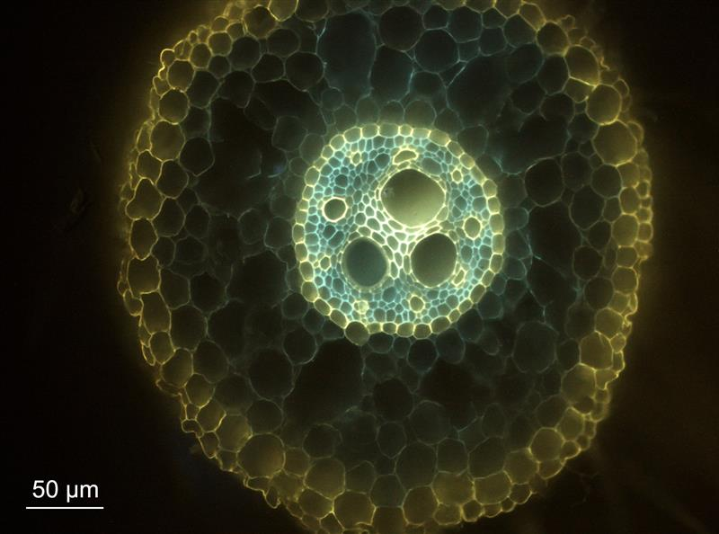
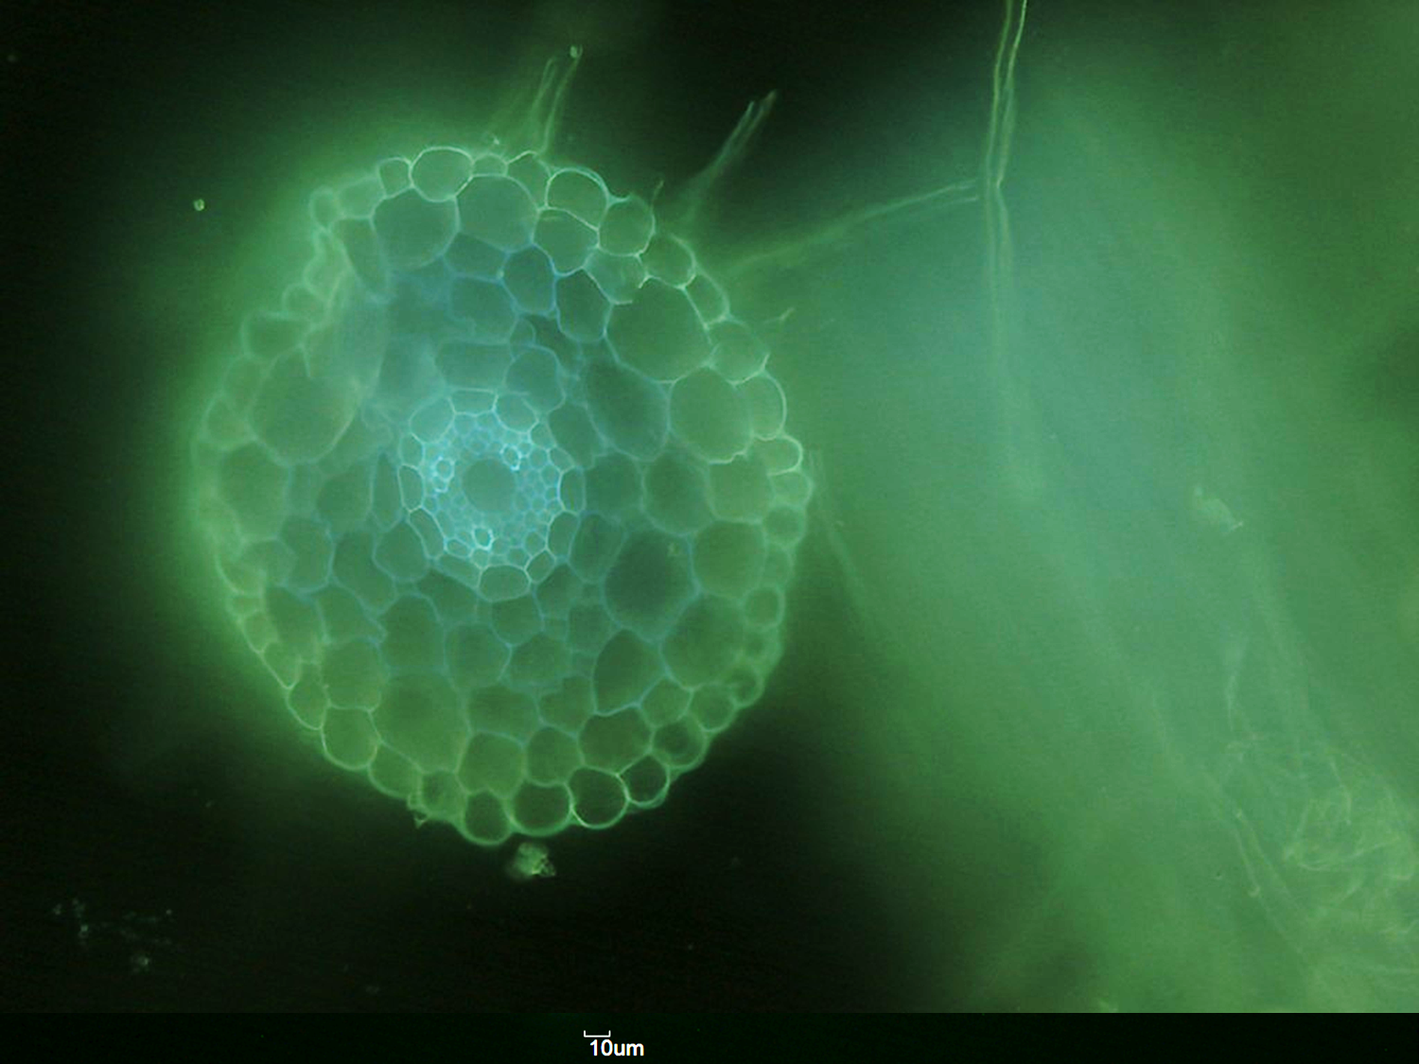
HANDS ON GRANAR
Try to reproduce one of these anatomies
Principal root maize B73
Lateral root maize B73
- Modelling Root Hydraulic Anatomies -
17

Slide 18


Slide 19
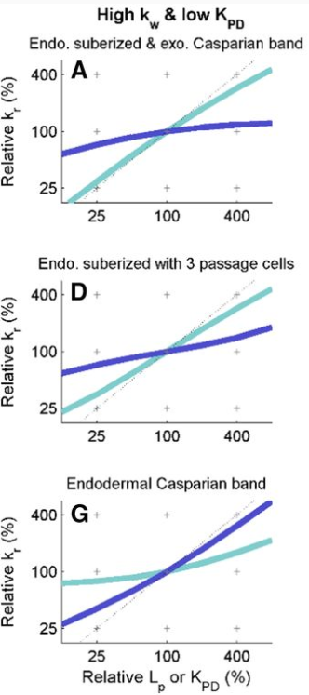

SENSITIVITY ANALYSIS

Slide 20
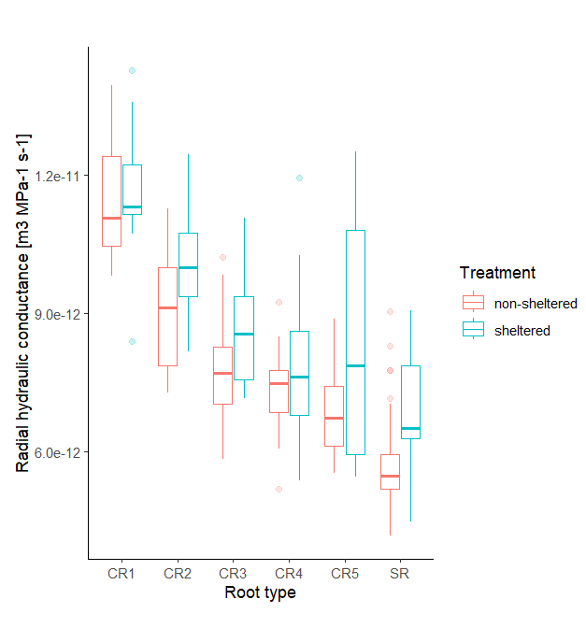
If roots from higher crown numbers show greater hydraulic conductance, what does this suggest about their internal structure?

Slide 21
SIMULATING ROOT ANATOMIES
- GRANAR & MECHA -
What did I like about today?
What did I learn?
What will I do next?
- Modelling Root Hydraulic Anatomies -
21

Slide 22
